Slide 1
ENVIRONMENTAL MONITORING
Team MEMBERS:
ABISHEK S
ARUNACHALAM S
SIVARANJINI V
VIMAL M

Slide 2
PROJECT STATEMENT
The project involves setting up IoT devices to monitor environmental conditions in public parks, including temperature and humidity. The primary objective is to provide real-time environmental data to park visitors through a public platform, enabling them to plan their outdoor activities accordingly. This project includes defining objectives, designing the IoT sensor system, developing the environmental monitoring platform, and integrating them using IoT technology and Python.

Slide 3
OBJECTIVES OF THE PROJECT
Smart Park: Elevating Outdoor Experiences with IoT Environmental Intelligence, aims to deploy IoT sensors for real-time environmental monitoring in the park. We will enhance visitor experiences with personalized AI-driven recommendations and augmented reality content. Collecting visitor feedback will drive continuous improvement. Our commitment extends to environmental conservation, community engagement, sustainability, and data security. Innovation is a core focus for platform evolution.

Slide 4
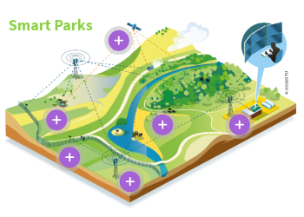

Slide 5
LIMITATIONS OF EXISTING ALGORITHMS
Computational Complexity: Some algorithms are computationally demanding and slow.
Data Sensitivity: Algorithms can be sensitive to data quality and quantity.
Overfitting and Underfitting: Machine learning algorithms may over-specialize or underperform.
Interpretability: Complex algorithms may lack transparency and interpretability.
Scalability: Some algorithms struggle with large datasets.

Slide 6
Adaptability: Many algorithms don't adapt well to changing data.
Resource Requirements: Some algorithms need significant computational resources.
Robustness Issues: Vulnerability to adversarial inputs or attacks.
Ethical and Legal Concerns: Algorithms can raise privacy and discrimination concerns.
Cold Start Problem: Difficulty in handling new or limited data scenarios.
Complex System Interactions: Understanding interactions between components can be challenging.
These limitations should be considered when selecting and designing algorithms for specific tasks.

Slide 7
CONCEPT OF PROPOSED METHOD / ALGORITHM
The proposed method, tentatively named Smart Park and addresses the critical problem of monitoring the Environmental conditions in the public park . Our primary objective is to a Smart Park leveraging a novel approach. At its core, the method relies on IOT Technology and is comprised of several key components, including some Sensors Notably, Smart Park offers distinct advantages such as Enhanced air and gives guide using display boards and Software Applications etc. , though we acknowledge challenges related to this but Its applicability spans across the Applications, making it a versatile solution. What sets our method apart is it’s the innovation, which promises to advance the field. Looking ahead, we envision the Future Directions for further refinement and expansion of this promising approach.

Slide 8
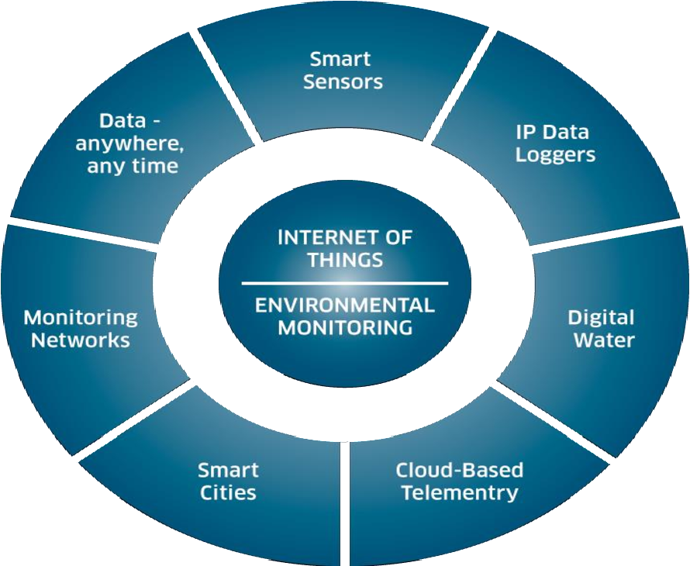

Slide 9
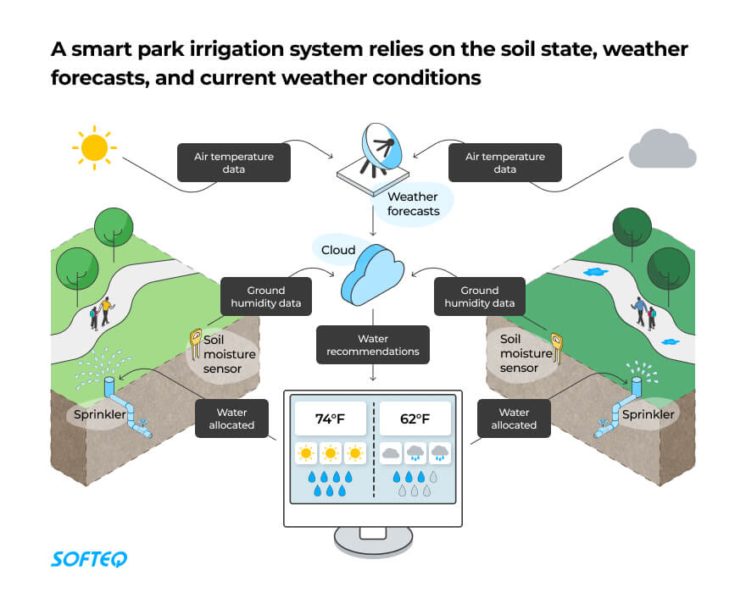

Slide 10
DETAILS OF ALGORITHM
Integration Approach - Brief Summary:
The integration approach involves IoT sensors collecting environmental data, which is transmitted to a central gateway and securely relayed to the web-based platform. Data processing includes validation, transformation, and real-time analysis. Users access the platform through secure authentication, and a notification system provides updates on environmental changes and planned activities, ensuring a user-friendly and data-secure ecosystem.

Slide 11
CONCLUSION
Smart Park: Elevating Outdoor Experiences with IoT Environmental Intelligence, is poised to revolutionize the way visitors interact with public parks. Through real-time environmental monitoring, personalized activity planning, and an unwavering commitment to sustainability, we aim to create a seamless fusion of nature and technology. This endeavor promises not only to enhance visitor satisfaction but also to contribute to the preservation of our precious outdoor spaces. With innovation as our guiding principle, we're embarking on a journey toward a smarter, more enriching, and ecologically responsible future for park enthusiasts worldwide.

Slide 12
REFERENCE
"Foundation". Smart Parks. 2017-05-01. Retrieved 2023-02-10.
SMART Parks™, “A Toolkit, Luskin Center for Innovation” (UCLA), 2018
Peter Harnik, Jessica Sargent and Jennifer Plowden, “The Economic Benefits of the Public Park and Recreation System in the City of Los Angeles, California, s.l” The Trust for Public Land, 2017.

